Slide 1
HOME
About
Capabilities
Contact
Testimonials
Web and app conversion improvement and customer retention
UX, web design and development
Content strategy, copywriting and professional writing
SEO and online marketing
Local SEO and online marketing for small businesses
Digital, app and creative strategy
e-Commerce design and development
Social media
Virtual Reality, Augmented Reality and Wearables
Creating memorable brand and retail spaces
Nuggets
Blog posts
App design and development
Essex
London
Norfolk and Suffolk

Slide 2
Link to template: https://undsgn.com/uncode/homepages/creative-digital-agency/
Capabilities / Testimonials / Contact
Don’t wait for the future, be the future
Local businesses and big brands alike.
We can help you create human-centric customer experiences using the best creative design, marketing, web design, media and technological expertise for businesses who seek to be the best at what they do.
Strategy
Content
Design
TECHNOLOGY
Capabilities
EXPLORE
Produce the blog area, put in dummy content for now
How many logos appear in total?
Remove Contact form

Slide 3
https://undsgn.com/uncode/pages/services-clean/
WLW is a future creative consultancy
We believe inspired creativity and efficient productivity comes from trust and leadership from experts in their field. Together we enable omnichannel experiences for clients who seek to be the best at what they do.
Successful working relationships, inspiration and performance flourish through trust and leadership
Challenge means fresh thinking and innovation
Enabling better experiences through creative and technological expertise
Believers in the development of new expert collaborative partnerships within creative, media, consultancy and technology
We drive our team’s and clients’ professional ambitions to grow sustainably
We have experts on the ground in some cool places
Our base of operations is Great Britain, but through our associate network we can deliver projects and campaigns in most of the World: London, Essex, Suffolk, Dorset, Chicago, New York, Europe, Dubai, China and Thailand.
The future of brand is harnessing agility in finding purpose and meaning behind its existence in peoples lives.

Slide 4
https://undsgn.com/uncode/blog/blog-boxed-bigtext/
NUGGETS

Slide 5
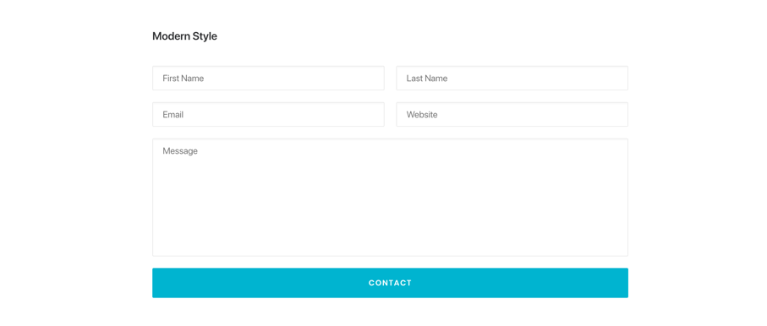
https://undsgn.com/uncode/pages/contact-clean/
https://undsgn.com/uncode/features/contact-forms/

Slide 6
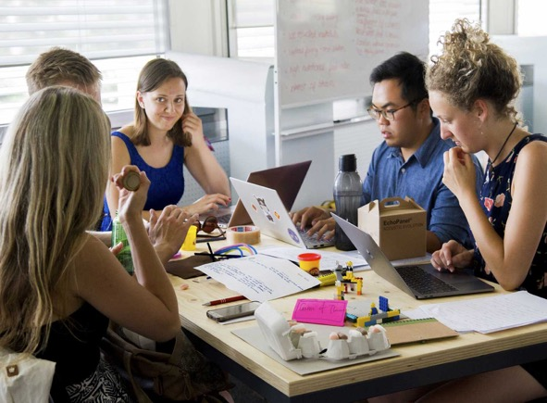
https://undsgn.com/uncode/portfolio/sidebar-custom-one/
White label hire for agencies, consultancies and in-house
wlw-future-White-label-hire-for-agencies,-consultancies-and-in-house.jpg

Slide 7
https://undsgn.com/uncode/portfolio/sidebar-stack/
Award-winning UX, web design and development
We've helped small businesses, advertising agencies and big brands with award-winning, affordable and flexible website solutions since 2004. We specialise in web consultancy, analytics, information architecture and wireframes, user experience (UX), content strategy, copywriting, production & management, web design and CMS development. From 2010, we started to focus on helping clients achieve their KPIs through brilliant design, a strategy that yielded between 50% to 75% increases in online revenue. One of our UX studies alone can make a huge improvement in how to make your design and customer journeys flow more efficiently.

Slide 8
https://undsgn.com/uncode/portfolio/sidebar-custom-one/
Content strategy, copywriting and professional writing
Developing compelling, sharable copy, refined for SEO and dedicated to superlative per-click conversion, we write persuasive brand editorial for e-commerce, websites, LinkedIn, Facebook, blogs, microsites, standalone documents, white papers, press releases and product pages.
Our successful and published writers are creative, professional and proficient in generating content that will attract, engage and retain customers and clients for any business.

Slide 9
https://undsgn.com/uncode/portfolio/centered-stack/
SEO and online marketing
Our digital media process, which includes content marketing, web copy, email marketing, general SEO and utilising Google AdWords, LinkedIn and Facebook advertising, has produced measurable results for the UK and international businesses that use our services. We can show you how we use the best digital media channels with the overall aim of getting more business.
Our mantra is:
1. Targeting customers at the right time.
2. Compelling propositions lead to clicks.
3. Ongoing cost per click improvement through analysis and by producing actionable insight at every stage.

Slide 10
https://undsgn.com/uncode/portfolio/centered-stack/
Localised SEO and online marketing for small businesses
We will produce a free SEO marketing report for your website and touchpoints and show you exactly where you are on your local or regional map. Then it’s up to you to choose how you want to proceed. We provide services to optimise the copy on your website to suit your business focus, create content throughout various channels that will get seen by more people, look at how you can improve your visual identity and make sure you’re submitted to as many online directories as possible.
When 73% of consumers lose trust in a brand which has an incorrect online listing and when 43% of all Google searches are local, using local and regional SEO within your region, or even your town, has never been more important or effective. We’ll submit your business listing to 525 UK directories including Google, Bing, Freeindex, 192.com, Scoot and Yell. Then monthly, or as you require it, we’ll ensure that all of your information across all directories is up to date and correct using our centralised platform, a service that will help with your local SEO ranking against your competitors. We save you time letting you focus on what really matters - your business.

Slide 11
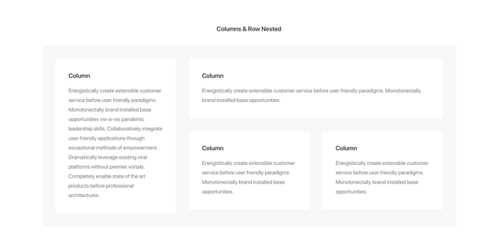
https://undsgn.com/uncode/portfolio/centered-custom-one/
Award-winning digital, app and creative strategy
The existential threat of the digital age is causing disruption to many businesses that do not have the talent to shift with their customers fast enough.
These could be some of the questions you are asking yourself:
How can I improve the mobility of my team around the country?
Why are B2B & B2C purchase cycles the way they are for my business?
I need an effective, memorable and measurable campaign.
Can you give me better ROI on my e-commerce shop?
My company needs online brand ambassadors.
I need to develop actionable insights.
How can I improve customer support using digital?
We need clear value propositions for our products online.
WLW FUTURE will reveal how your business can become more efficient and how we can add value to create more customer-centric products and services that are as agile as your digital customers. We can help you deliver your idea, startup, product, brand, story or service to your customers in the only way, the right way.
Discovery
Workshops
Vision and objectives
Customer, market, trends, competitor research and survey tools
Personas, profiling and stakeholder interviews
Value proposition development
Customer journey mapping
Customer experience development
Content strategy
Brand architecture
Information Architecture, sitemaps and wireframes
User Experience (UX)
Prototyping
Creation
Branding development
Content production
Design concepts and development
e-Commerce and Omnichannel experiences
Mobile and app experiences
Animation and stories
Marketing and competition mechanics
Agile and project management excellence
Experience
Enterprise CMS and e-commerce solutions
Open source community CMS solutions
Social media apps and platforms
Augmented Reality
Virtual Reality
Mobile, apps and wearables
Email marketing and CRM
Live artists
Events
Social gaming
Film and video
Retain
Analytics and KPI-driven insight
SEO and SEM optimisation
A/B testing, eye-tracking, heat mapping and customer interviews
Customer retention
Product and brand review cycles
Customer service support
Operational Excellence (OPEX)
PR value creation
Media piggybacking
https://undsgn.com/uncode/features/rows-columns/

Slide 12
https://undsgn.com/uncode/portfolio/centered-custom-two/
Award-winning e-Commerce design and development
Today and into the distant future, the ability of customers to find better ways to research and review your brand, product or service has changed the customer journey forever. Good e-commerce solutions enable business models to connect with customers in places previously difficult to find. We’ll help you find the barriers of conversion by not just looking at your online customer journey, but your entire customer journey, to see how your digital presence can enhance conversion.
There are many ways to get your products onto the web from cost-effective off-the-shelf solutions to bespoke omni-channel, multi-language online shops. We can get you setup with payment methods such as VISA and PayPal, ensure your customer data is safe with SSL and give you full content production, e-commerce support and tutoring for your team.
We've helped one of our agency clients pick up related awards for the last 6 years whilst working with them to solve their own clients’ needs. We also work with SMEs and big brands alike on delivering the ultimate online customer experience.

Slide 13
https://undsgn.com/uncode/portfolio/sidebar-stack/
Social media
Back in 2007, at the birth of fast broadband and social media as we know it today, WLW helped an agency with a pioneering social media campaign for Lexus. A blog connected customers with engaging articles from social influencers such as Bob Geldof. The approach was successful enough for the blog and campaign to be featured on the news. We also helped RSPCA find its voice within social media, connecting its brand to children who wanted to campaign through a kids’ social network. Today, not much has changed, except how social media is now consumed by the vast majority of people whenever they go online. This means it’s integral to understand your business’s voice in this space.
We curate and create content that tells your campaign’s story. We look at how we can seed and nurture the content into the right customer communities, 7 days a week, 365 days a year. We have a network of social influencers across the Internet who are authentic people that can engage your customers. We harness the potential of your campaign by analysing behaviour and sentiment then using that insight with action we believe will amplify your story.

Slide 14
https://undsgn.com/uncode/portfolio/centered-stack/
Virtual Reality, Augmented Reality and Wearables
We can help you increase brand awareness for your marketing projects by creating "world firsts" in terms of uses of technology. Using AR and VR can help position your business and brands to be innovative and exciting. We use bespoke analytics that will give you increased dwell time at exhibition stands and installations, increased social media reach and increased effectiveness/recall of immersive projects. We also supply research and development including use of AR and VR for production lines, visualisation and simulation for design, staff training, online payments and interactions in virtual space.

Slide 15
https://undsgn.com/uncode/portfolio/centered-stack/
Creating memorable brand and retail spaces
We can turn a flagship store or venue into an innovation space that will be a transactional destination for culture, music, social and tech alike. Imagine a social and sharable virtual concert/show experience that can promote all product/brand channels extending reach and ROI. We can do live streams (a live link from a 360 degree camera on stage), high profile concerts and a selection of priority customers or competition winners will receive an invitation to the store or venue to view the concert live in mobile VR. By turning a retail space into a ‘virtual venue’ we give customers a reason to have a physical connection with a brand or product. Our partner’s flagship store experiences with Top Shop proved that there are massive ROI gains to be made through brilliant PR.

Slide 16
TESTIMONIALS
“I met David when searching for a partner to support me develop Total Flow’s brand, web presence and marketing strategy Of the twenty or so companies I met David stood out a mile. He is intelligent, ferociously creative and technically savvy. He has a large and capable network and was able to bring to our organisation capabilities previously beyond our reach. Unlike many he invested time to understood our brand and values and then produced magic to capture the essence of our organisation in a way our customers find compelling. Not a bad trick to pull.”
— Chris Ellins, Group Managing Director, Total Flow Limited
“David is a superb project manager, with some exceptional forward-thinking ideas to increase website conversion and improving the user experience. Capable of handling very demanding client requirements whilst maintaining his professional integrity, and keeping the project on track in the face of adversity. David is highly knowledgeable not only of marketing best practices, but also the more technical restrictions of eCommerce platforms, SEO, PPC and site conversion optimisation.”
— Richard Levi, Loc8tor
“David was responsible for the roll out of a significant e-commerce project. despite the short timelines he was able to get a good grip on the tasks that needed to be completed and laid down the correct processes to ensure that all the parities completed the project on time. I was very impressed with his ability to pull together the various strands on the project and mediate between all parties to ensure the projects success”
— Simon Scott, Push Entertainment
“David’s extensive experience as a digital strategist has produced outstanding results for a broad range of clients. He has an excellent grasp of the online environment and the multiple opportunities within it for effective and constantly upgradeable commercial solutions. He is also imaginative about driving audience interest and participation. Quick witted and resourceful. I can strongly recommend him.”
— Paul Vinogradoff, Pajama
“David delivers great solutions for difficult ecommerce and web problems, an innovative and friendly team member who’s driven to deliver.”
— Chris Birch, Joystick Junkies
“David offers a rare creative & commercial talent. The ability to distill & apply creative solutions both on and offline with astounding technical knowledge. Innovation happens at the edge, this is the space David occupies.”
— Doran Tranmer, MWI
“David is one of the most creative people I’ve worked with. He has a great strategic appreciation of where the Web is going and how to exploit it for marketing, education, games and business in general. You’ll find he’s also brimming with creative ideas for his own initiatives and for yours”
— Robert Hart-Fletcher, KidsOKOnline
“David is an open minded, entrepreneurial and insightful creative thinker, who’s not afraid to question how things are being done but, simultaneously, who has a strong grasp of the commercial objectives. David approaches the challenges of marketing comms with energy, commitment and endless enthusiasm.”
— Andrew Crysell, CrowdDNA
“David and I have worked on various projects together over the past two years and he never ceases to inspire me. He manages to combine a creative mind with strategic and logical thinking – a rare combination. He’s always brimming with ideas and solutions. At LazyTown, he produced a highly detailed and well thought out analysis of their digital offering that led to a major rethink about the way the company viewed online. Finally, when it comes to presentation, he is a master. I couldn’t recommend him highly enough.”
— Suzanne Noble, International PR & Marketing Director, LazyTown Entertainment
https://undsgn.com/uncode/pages/services-clean/
https://undsgn.com/uncode/features/typography/

